Slide 1
Database Projects – Problem Specification

Slide 2
Introduction
Your project should start by describing the background to the problem. Ideally you will have a real user and a real problem.
Identify who is the client.
Identify who is the user. (This may or may not be the same person.)
Identify their organisation.
Identify the client’s role and the user’s role in the organisation.

Slide 3
Background
It may be useful to:
outline the size of the organisation in terms of business, e.g. number of customers, orders per day
give an overview of the problem in terms of the information they use and require, e.g. customers’ names, prices
outline some of the problems the existing system is causing, e.g. time-consuming, inaccurate information.
This section does not need to carry any real detail such as the price of a lesson as your research will do that later.

Slide 4
Interviewing the user
The next stage is to find out exactly what the end user requires or ‘What they want you to do!’
This is likely to take the form of:
a formal interview with the user
a questionnaire where you document the replies
actual observation at the place of work.
The interview could be face-to-face, over the phone or by email.
It could be a series of interviews and follow up interviews with the user.

Slide 5
Research – Interview the user
The purpose of the interview is to:
understand the problem in enough detail to be able to set about providing a solution
establish how the current system operates
identify any problems in the current system
collect and analyse any existing documents
establish the end user requirements or ‘what they want you to do’.

Slide 6
Research - Interview questions
Prepare your questions beforehand to save time and make sure that you don’t miss anything.
For the retail database you would want to find out as a minimum the following information:
What information do you keep about customers and orders?
Could I see how you order new products?
What are the different categories of products and what is the pricing structure?
What is the procedure when someone sends in an order?
How are stock levels recorded each day?

Slide 7
Interview Questions
How do you deal with cancellations? Do you keep records?
What is the procedure when someone does not pay their bill?
How is the catalogue created?
How long do you keep customer details on file?
What happens if a student decides to change their order.
What computer facilities do you have at present (if any)?

Slide 8
Document Analysis
Look at examples of existing documents such as:
catalogues
customer records
booking timetables
customer and supplier orders
invoices
credit agreements
supplier details
delivery notes
stock lists

Slide 9
Research - Document Analysis
The purpose of looking at examples of existing documents is to:
identify logos and house styles for interfaces
identify layouts and letterheads for printed output
identify data to be used in the system
identify how data is stored
identify data needed for data entry screens
identify how data moves through the system.

Slide 10
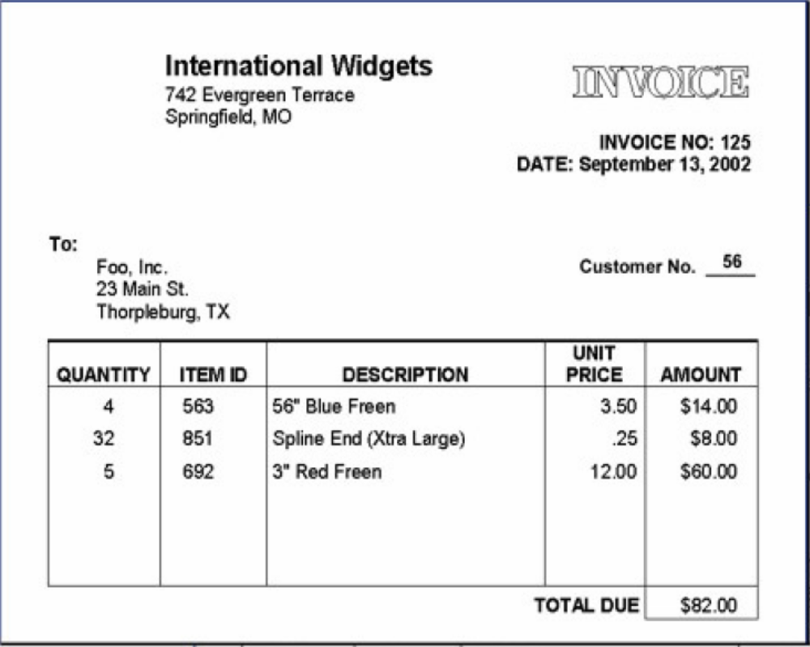
Example Document Analysis
This is an invoice from a retail business.
You need to consider the data that is entered.
It is easier to do if you use the document analysis form provided.
This will help you describe the current system.

Slide 11
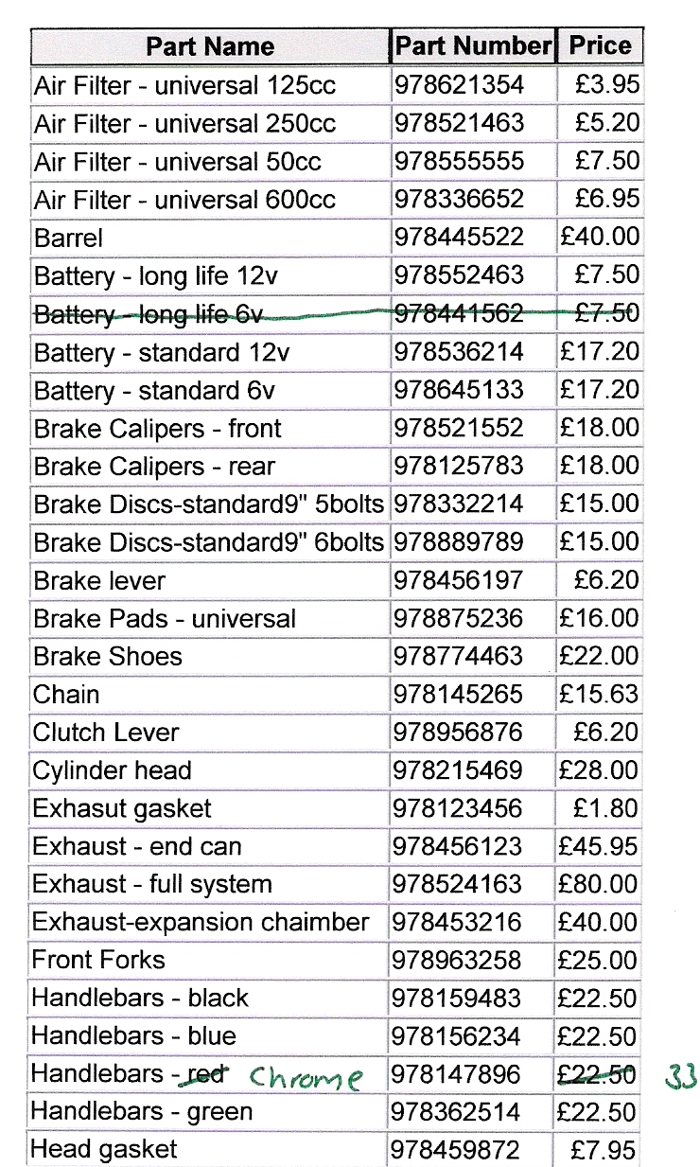
Example Document Analysis
It is useful to fill in a document analysis form.

Slide 12
Current System
You should now be able to:
describe clearly and in detail all parts of the current system
identify all the key processes, e.g. making a quotation, filing the quotation, clearing the screen, adjusting prices, adding a customer, etc.
analyse existing documents
list some of the problems in the current system
state your end-user requirements.

Slide 13
Current System
In the retail system, some of the parts you will need to be able to explain are:
details of the different products and the pricing structure
how customers order products and what data is stored about them
how stock is ordered from suppliers; what the process is and what data is stored
how daily, weekly and monthly financial reports are produced.

Slide 14
Current System - Problems
You will also recognise some of the problems in the current
system.
For example in the shop:
When taking an order and searching for available stock can be a lengthy process.
Making sales reports is inefficient because they have to be rewritten by hand and photocopied.
Making orders from suppliers by monitoring stock takes too much time.
Calculating income and tracking payments is error prone.

Slide 15
End User Requirements
This is quite simply a list of all the things the user wants you to do.
Example 1 - I want a list of all products whose stock levels are critical
Example 2 - I want quick access to details of all sales.
It should not be written in technical language, e.g. my user wants me to set up a relational database.
It should contain as much detail as you can offer.
Ideally it would be signed off by the user to say that they agree with the requirements.

Slide 16
End User Requirements
Other examples of end user requirements in the database
store details of customers and their contact details.
issue copies of daily sales to manager including financial summaries.
speed up the time it takes to order an item from a supplier, searching for stock levels and recording customer orders
easily maintain and issue weekly and monthly reports, including charts, on sales by product, by assistant and by customer.

Slide 17
Resources
You will need to consider the hardware and software resources available to you and the user.
Raise any issues and make recommendations about hardware and software such as PC specification, printer needs, software requirements, compatibility, connectivity, monitor size, screen resolution, backup, etc.

